Slide 1
5-ng/mL THC Permissible Inference Law
C.R.S. 42-4-1301(6)(a)(IV)
HB13-1325
If at such time the driver’s blood contained five nanograms or more of delta 9-tetrahydrocannabinol per milliliter in whole blood, as shown by analysis of the defendant’s blood, such fact gives rise to a permissible inference that the defendant was under the influence of one or more drugs.

Slide 2
  The 5-ng limit is scientifically invalid
“.. a quantitative threshold for per se law for THC following cannabis use cannot be scientifically supported.”
AAA Foundation for Traffic Safety (2017)
National Safety Council
https://www.nsc.org/getmedia/8840b317-9960-48b9-a3ae-3fec77a9448b/position-on-cannabis-and-driving.pdf
Int’l Ass’n of Chiefs of Police
https://www.theiacp.org/sites/default/files/View%20the%20recently%20adopted%202018%20Resolutions.pdf
Nat’l Sheriff’s Association
https://www.sheriffs.org/sites/default/files/2018-01.pdf
Nat’l l Highway Safety Administration
https://www.nhtsa.gov/sites/nhtsa.gov/files/documents/812440-marijuana-impaired-driving-report-to-congress.pdf
Nat’l Ass’n of District Attorneys
https://maricopacountyattorney.org/DocumentCenter/View/457/NDAA-White-Paper-on-Marijuana?bidId=

Slide 3
The 5-ng limit is scientifically invalid
Here is what all these groups have learned:
Neither alcohol nor THC impair a driver’s blood.
These and other drugs impair a driver’s brain.
Alcohol is water soluble
Uniform concentration in the body
What’s in the blood is in the brain
Is only consumed orally
BAC is a useful tool to assess DUI
THC is fat soluble
Rapidly redistributed from blood to brain
Brain level is much higher than the blood
Is consumed orally and directly to lungs
Blood THC content cannot assess DUI
Notes:
First of all, you need to appreciate that neither alcohol nor THC can impair a driver's blood. These and other drugs impair a driver's brain. It's the brain, not the blood that makes a driver behave badly. When alcohol is consumed, it become uniformly distributed throughout the body, so what’s in the blood is in the brain and vice versa. When marijuana smoke or vapor is inhaled, its THC goes directly from the lungs to the blood stream where it is very quickly extracted from the blood by the brain and other fatty tissues and organs. The average adult heart pumps the entire body’s blood volume once each minute through the brain, so this redistribution occurs very rapidly. Alcohol is consumed orally, but THC is consumed both orally and by smoking or vaping. These two different modes of THC consumption create two entirely different pharmacokinetic profiles as you will see on the next slide. The result is that blood alcohol level can be a very good indicator of alcohol level in the brain, but that is not true for THC.

Slide 4
Colorado’s DUI reporting system
Office of Research & Statistics, Colo Dept Public Safety
Court databases
State judicial
Denver courts
Behavioral health
Toxicology databases
CBI toxicology lab
Denver crime lab
Intoxilyzer data
DUI Report
Prevalence data by substance(s)
Crash risk by substance(s)
Conviction by substance(s)
+
Limitations:
Refusals
Limited drug tests

Slide 5
Causes of 2020 Colorado DUI Cases
Sources: 21,066 cases, 2020 CDPS report
Non-alcohol drugs:
37% cases tested for drug and alcohol
22% tested for alcohol only
41% no test data available (refusals)
Alcohol: Two CDPS estimates 35% & 60%

Slide 6
Conviction rates by cause
Alcohol only 94%
Polydrug 90%
Other single drug 79%
THC only 74% (45% for DUI, 98% for DWAI)
Note: Colorado 4-year average figures for 2018-2021
Note: This combines convictions for DUI and DWAI
Note: Includes findings of Guilty, Deferred and Deferred/Dismissed
Sources: CDPS annual DUI reports 2018-2021

Slide 7
Colorado’s “DUI” Offenses
 | DUI - DUI per se | DWAI
Name | Driving Under the Influence | Driving While Ability Impaired
Definition | Incapable of safe driving | Impaired to the slightest degree – less safe to drive
Alcohol legal limits | .08 per se | .05 permissible inference
THC legal limits | 5 ng/mL permissible inference | N/A
Note: THC’s 5 ng/mL law applies only to DUI, not to DWAI

Slide 8
Convictions by charge & THC level
DUI DWAI
5 ng+ 64% 99%
<5ng 8% 94%
A 5 ng THC limit does not discriminate between impaired and non-impaired drivers.
Notes:
Here we see the conviction rate by charge and by THC level for defendants impaired only by marijuana. For those charged with DWAI we find that the 5-ng THC limit does not discriminate between impaired and non-impaired drivers. Both categories of drivers, above and below the 5-ng level had similar extraordinarily high conviction rates. The 5-ng limit is irrelevant.

Slide 9
Convictions by charge & THC level
DUI DWAI
5 ng+ 64% 99%
<5ng 8% 94%
It’s easier to prove impairment than “incapable of safe driving.”
Permissible inference prevents convictions based on only toxicology results.
Notes:
Next, compare the DUI and DWAI conviction rates for those drivers who tested at or above 5 ng of THC. The DWAI conviction rate was 50% higher than the DUI conviction rate. We learn two things from this comparison. First, the permissible inference language in the law does indeed prevent DUI convictions based solely on toxicology results. Second, it is easier to prove impairment than it is to prove incapability of safe driving.

Slide 10
Convictions by charge & THC level
DUI DWAI
5 ng+ 64% 99%
<5ng 8% 94%
A 5 ng THC level prevents most convictions of impaired drivers below the legal limit.
Notes:
And finally, look at the DUI conviction rates for those above and below the 5 ng limit. We learn that the 5 ng THC limit prevents most convictions of impaired drivers below the 5-ng limit that we now know to be invalid. The conviction rate for those below 5 ng is only one-eighth of those who are above 5 ng. Does that really matter? How many marijuana-impaired drivers test below 5 ng/mL of THC?

Slide 11
A “legal limit” is not needed to convict
DUI DWAI
5 ng law No 5 ng law
Charges 1,303 1,554
Convictions 586 1,528
Conviction rate 45% 98%
The high DWAI conviction rate (which has no 5 ng/mL provision) is evidence that THC legal limits are not needed to achieve good conviction rates.
72% of THC only convictions were for DWAI
Keys to conviction: Avoid use of a THC “legal limit”
Charge DWAI, not DUI
Charge impairment, not incapable of safe driving

Slide 12
Legal definitions of drugged driving
Like Colorado’s DUI Like Colorado’s DWAI
“incapable of safe driving” “impaired to the slightest degree, less safe to drive”
AR Skills & Judgment altered AZ Impairs to slightest degree
DC Can be perceived DE Less able to clear judgment
FL Normal facilities impaired GA Less safe to drive
HI Impairs mental faculties KY Impairs driving ability
MS Impairs ability to operate. MT Ability is diminished
NH Impairs ability. NY Ability is impaired
PA Impairs ability to drive safely SC Faculties materially impaired
TN Impairs ability to operate. TX Not normal use of faculties
VA Impairs to slightest degree. VT Impaired to the slightest degree
WA Affected by
AL ND
IL SD
KS UT
MD WI
NV WY
NM OK

Slide 13
Avg. BAC 0.16
Sources: CDPS annual DUI reports 2018-2021
(2018 data unavailable for Alcohol, THC and Other)

Slide 14
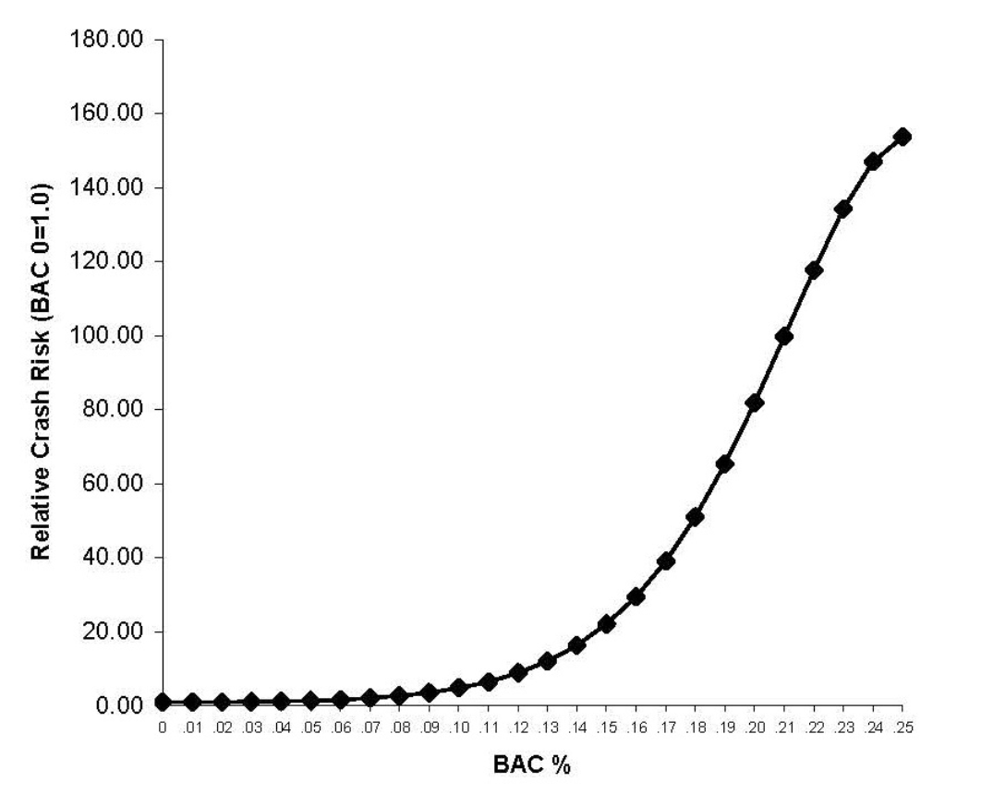
BAC vs adjusted relative crash risk
Alcohol only RR_{0.16} = 30
THC only RR 46% x 30 = 14
Source: NHTSA DOT HS 813 233 (2022)

Slide 15
If Colorado knew in 2013 what it knows now, would the 5-ng law have passed?
References:
Latest Colorado DUI report
  Rochelle R, Rosenthal A. Driving Under the Influence of Drugs and Alcohol. Colorado Department of Criminal Justice, July 2024
  https://cdpsdocs.state.co.us/ors/docs/reports/2024_DUI-HB17-1315.pdf
Colorado law requiring DUI report
  C.R.S 24-33.5-520
  https://colorado.public.law/statutes/crs_24-33.5-520
Published manuscript on today’s presentation
  Wood E. Colorado drugged driving prevalence and impaired driving conviction rates: Effects of impaired driving definitions and a 5-nanogram limit for delta-9-tetrahydrocannabinol. Traffic Injury Prevention. (2024) 25(3): 338-344 [Note: This manuscript contains only 3 years of data vs 4 years in the presentation.] https://doi.org/10.1080/15389588.2023.2296865

